Slide 1



Coffee Sales and Top Customer 2019 - 2022
View in Power BI
Last data refresh:
9/18/2025 4:26:49 AM UTC
Downloaded at:
9/18/2025 4:27:51 AM UTC

Slide 2
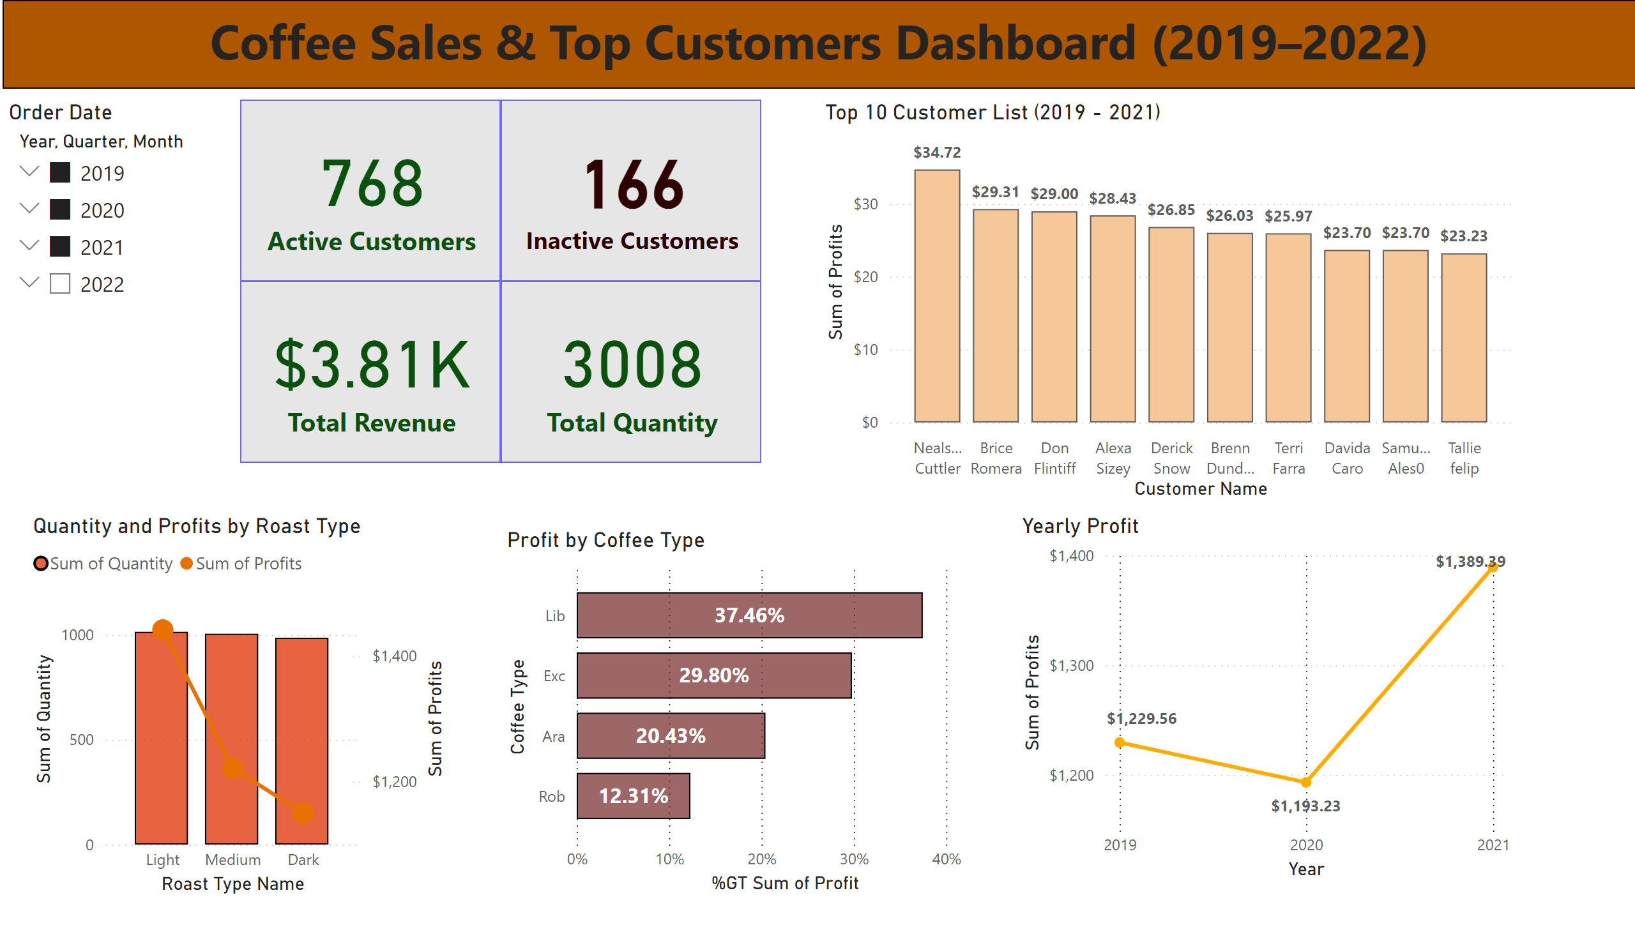
Page 1
Notes:
Quantity and Profits by Roast Type
No alt text provided
Yearly Profit
No alt text provided
Profit by Coffee Type
No alt text provided
Top 10 Customer List (2019 - 2021)
No alt text provided
Order Date
No alt text provided
card
No alt text provided
card
No alt text provided
card
No alt text provided
textbox
No alt text provided
textbox
No alt text provided
card
No alt text provided

